Slide 1

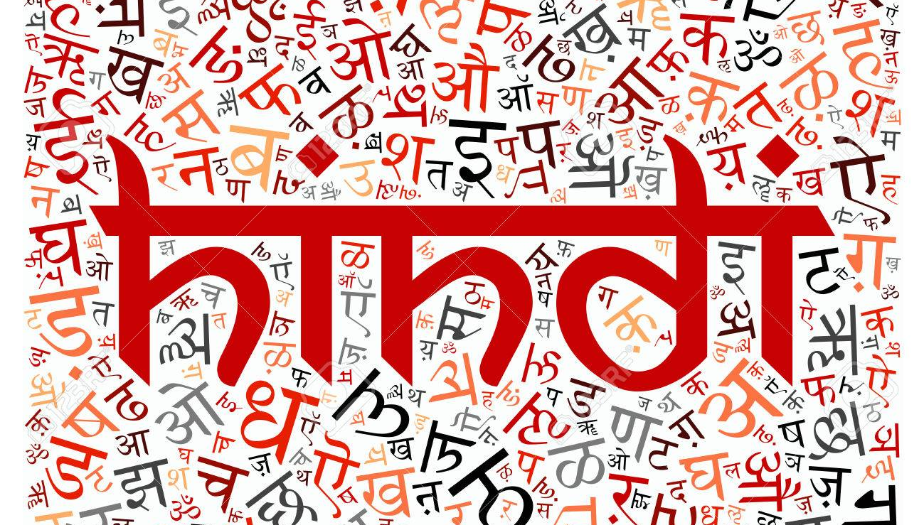

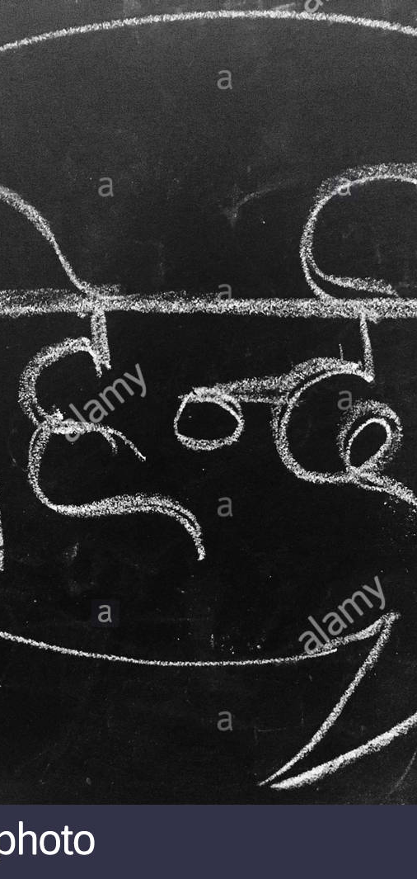
Project
Devanagari
Translation of Handwritten Hindi Font
To Digital Form

Slide 2
Outline
Theme Alignment
The Problem
Solution Proposal
Proposed Tech Stack
Industry Alignment
Market Place/Positioning
Efforts

Slide 3
Theme Alignment:
Data Science/Machine Learning

Slide 4
The Problem

Slide 5
Problem statement
There are drawbacks to handwritten text. It’s difficult to store and access physical documents in an efficient manner, search through them efficiently and to share them with others.

Slide 6
What people do today
In order to store handwritten text for future references or better analysis, people type the handwritten text to the Personal Computers.

Slide 7
Solution Proposal

Slide 8
Solution Description
Translation of Handwritten Hindi Characters to Digital Form by scanning and using CNN(Machine Learning) in order to store,access,search,share and analyse them efficiently and use them for future purposes.

Slide 9
Proposed Tech Stack

Slide 10
Proposed Tech Stack Description
Open Source:
Jupyter Notebook, Python, Keras, Dataset from UCI Machine Learning Repository

Slide 11
Industry Alignment

Slide 12
Industry Alignment:
Technology, Media & Communication

Slide 13
Market Place/Positioning

Slide 14
Market Positioning Description
Media especially Internet is filled with handwritten documents. Many times it is required to analyse them or refer them. Students use these handwritten documents to study teacher’s notes. So, converting the handwritten documents digitally just by scanning the document will reduce a lot of teacher’s time who have to type their written material manually on their personal computers. Also, where handwritten is sufficiently large, this technique will be a saviour.

Slide 15
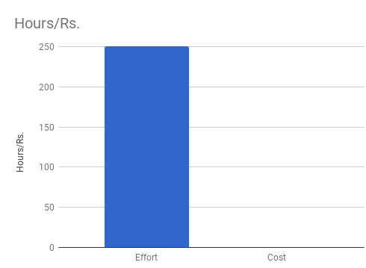
Efforts/Cost
1

Slide 16
References
https://archive.ics.uci.edu/ml/datasets/Devanagari+Handwritten+Character+Dataset
S. Acharya, A.K. Pant and P.K. Gyawali Deep Learning Based Large Scale Handwritten Devanagari Character Recognition ,In Proceedings of the 9th International Conference on Software, Knowledge, Information Management and Applications (SKIMA), pp. 121-126, 2015.

